Slide 1
WAP & WML

Slide 2
Create your first card
<wml>
<card title="Home Card" id="home">
<big>Our First Card</big>
<p>Welcome to our first WAP-enabled page. We're using WML1.3 to construct this deck of cards!</p>
<p>Here's a
</card>
</wml>

Slide 3
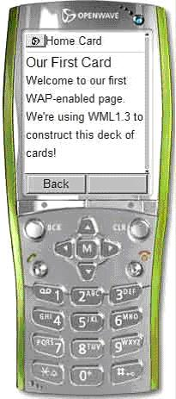
output would look like:

Slide 4
Building decks of cards
WML files can contains multiple cards-these files are known as decks.
Each card in a deck must be uniquely named. Cards are named using the <card > tag’s id attribute and id attribute , and id values may contain text and numbers(but no special characters).
When a deck is loaded the browser processes and stores all the contained cards and then determines which card to display.:
If a specific card id was requested and that id is present , that card is displayed.
If no card id is specified , or the requested id does not exists, the first card in the deck is displayed.

Slide 5
For example:
<wml>
<card id=“1”><p>This is card1 </p><card>
<card id=“2”><p>This is card2 </p><card>
<card id=“3”><p>This is card3 </p><card>
</wml>

Slide 6
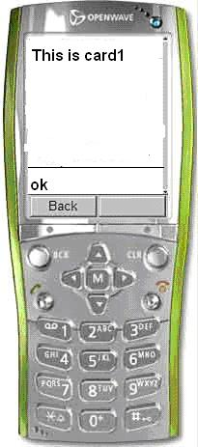
How to display particular card:
Localhost/wap/deck1.wml
Localhost/wap/deck1.wml#card1

Slide 7
Why we Use decks:
You provide a search screen that allows users to search for employees.
When a search is performed the results are listed with minimal information.
Each result can be selected for detailed information about the employee.

